Slide 1
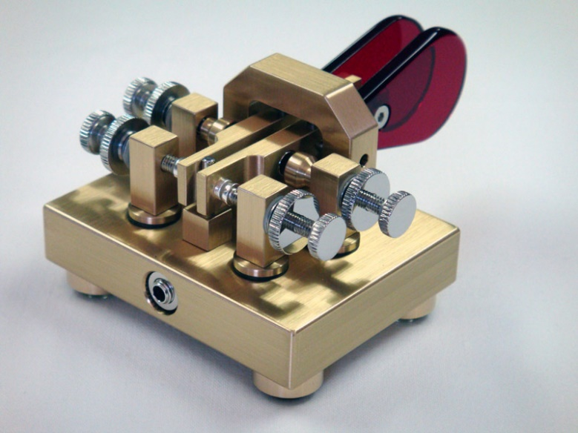
Learning & Using CW
Bob Beyer, KE2D
Tony Canuso, N2ATB
Rick Lawn, W2JAZ

Slide 2
When, Why, & How Did We Learn
Why we learned. How we learned. What did we do wrong. How we use CW then and now.
Rick, W2JAZ – Member of CWOPS & NAQCC
Tony, N2ATB – Member of FOC, SKCC, CWOPS & NAQCC
Bob, KE2D – Member of CWOPS

Slide 3
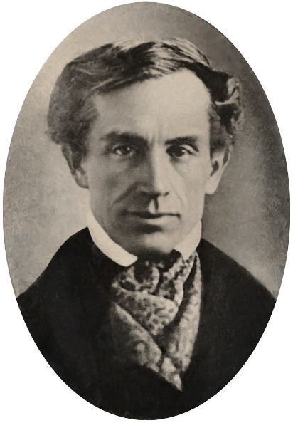
Samuel Morse
http://thememorypalace.us/2012/03/distance/
Notes:
The podcast leaves out some details that I think are important.
For example, Morse does not leave Washington immediately. He receives a letter from his father the next day telling him his wife has died.
This fact would have dramatically altered the tone of the story so I’m a bit disappointed by what I now feel is a somewhat deceptive telling of the story for the sake of poetic embellishment.
His wife apparently delivered their third child and then died shortly after. The podcast lets you believe that his wife was pregnant when she died.
Morse apparently does not become interested in telegraphy until roughly 7 years later in 1832 when he meets Charles Thomas Jackson while returning to the U.S. on a ship from Europe.
Jackson was experimenting with electro magnets. What Morse’s real inspiration and motivation were may be difficult to actually say
Morse was not the only one working on the telegraph and some earlier achievements by others are notable as well.
Morse was apparently bitter that he was not credited as the sole inventor and a patent law suit by him eventually reached the Supreme Court.
While the overall finding of the court was in his favor, they did not uphold all of Morse’s claims.

Slide 4
General notes on Morse Code
Two kinds of code:
International Morse Code
American Morse Code (almost extinct)
American International
C . . . C _ . _ . F . _ . F . . _ . J _ . _ . J . _ _ _ L ___[long dash] L . _ . . O . . O _ _ _ P . . . . . P . _ _ . Q . . _ . Q _ _ . _ R . . . R . _ . X . _ . . X _ . . _ Y . . . . Y _ . _ _ Z . . . . Z _ _ . .
American International
1 . _ _ . 1 . _ _ _ _ 2 . . _ . . 2 . . _ _ _ 3 . . . _ . 3 . . . _ _ 5 _ _ _ 5 . . . . . 6 . . . . . . 6 _ . . . . 7 _ _ . . 7 _ _ . . . 8 _ . . . . 8 _ _ _ . . 9 _ . . _ 9 _ _ _ _ . 0 _______ 0 _ _ _ _ _

Slide 5
General notes on Morse Code
Never use dots and dashes (like the previous slide ☺)
Morse Code is an audible system. Not a written one.
Still has other (non-ham) uses:
Aircraft and Nautical NDBs
Commercial Repeater IDs
Some Other Shortwave use: 4XZ @ 6607 KHz

Slide 6
CW for Contesting
Speed = Rate, Faster Speed = More QSOs/hour (EF8R)
Contest CW is Rapid Fire – Short Quick Buffer
Need to copy nearly random character groups quickly
Being a touch-typist is extremely useful
CW Contesters use “cut numbers”:
A = 1, E = 5, N=9, O or T=0
Most CW contesters let the computer send the CW
Paddle or key use is the exception for the majority
Narrow filtering is key for most ops: 150-500 Hz

Slide 7
CW for Contesting
Enhancements:
Call History (aka “pre-fill”) Files
These files help logging software predict what a station’s exchange will likely be.
You Should still copy what you hear.
Call History files are not gospel.
They have mistakes. Stations change classes or exchange info, etc.

Slide 8
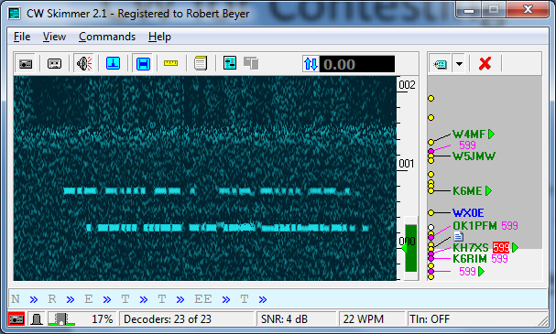
CW for Contesting
RBN network of “Skimmers”
RBN = Reverse Beacon Network
Beacons – Few senders, many listeners
Reverse Beacons – Many senders, few listeners (reporting)
Provide a virtual flood of spots
VE3NEA wrote a popular skimmer program

Slide 9
CW for Contesting
Example Recording from a CWT “mini test”
Speed is 34-44 WPM
N3JT - Jim 1
W9ILY - John 471
W1VE - Gerry 1N1 (191)
K2TW - Tom 2TTT (2000)
N2UU - Bob 121

Slide 10
Tools & Resources For Learning & Improving
Web based applications:
https://morsecode.scphillips.com/trainer.html
Excellent training endorsed by CWOPS
includes various learning modes: QSOs, Sending, Free Form, Random etc.
Can upload your own text files
http://AA9PW.com/morsecode
Excellent drills on letters, words & QSOs

Slide 11
More Resources…
http://ditdit.fm/resources (Long Island CW Club W2LCW)
Great collection of links to articles about learning CW – “Dirty Dozen”
Links includes Android and iPhone apps and widely endorsed computer applications including: G4FON Morse Trainer, Morse Runner (great for contest practice), RufzxP (also good for contest practice and G4FON Contest Trainer
Converts your text to mp3 file for playback and varying speeds you select
http://fkurz.net/ham/ebook2cw.html#gui
For a better explanation of how to install go to: KK5NA.com/ebook2cw.htm

Slide 12
https://mitxela.com/projects/morse_code_practice_tool
Offers news feeds in CW with variable speed and text to check accuracy.
RESOURCES OFFERED BY ORGANIZATIONS
ARRL offers on air practice sessions on a regular schedule, varying speeds
ARRL also offers mp3 practice files with text files to check your work
CWOPS & CW Academy
2 month classes at various levels
Online resources anyone can use including practice materials with answers: State abbreviations, Province Abbreviations, top 100 words, Jokes, typical QSOs etc.

Slide 13
HARDWARE
Various keyers, practice oscillators etc.
Enter the Morserino!!!
Amazing tool from Europe that does everything including functioning as a memory keyer.
Sold about 1500 so far!
https://youtu.be/6a_bf8O0c8U
CW is NOT dead despite the Digital Mode invasion. CW Academy has more students than ever. And there are others sponsoring
Will distribute a link to this presentation as well as various practice files distributed by CW academy.
73 sk dit dit
Questions or Comments

